Slide 1

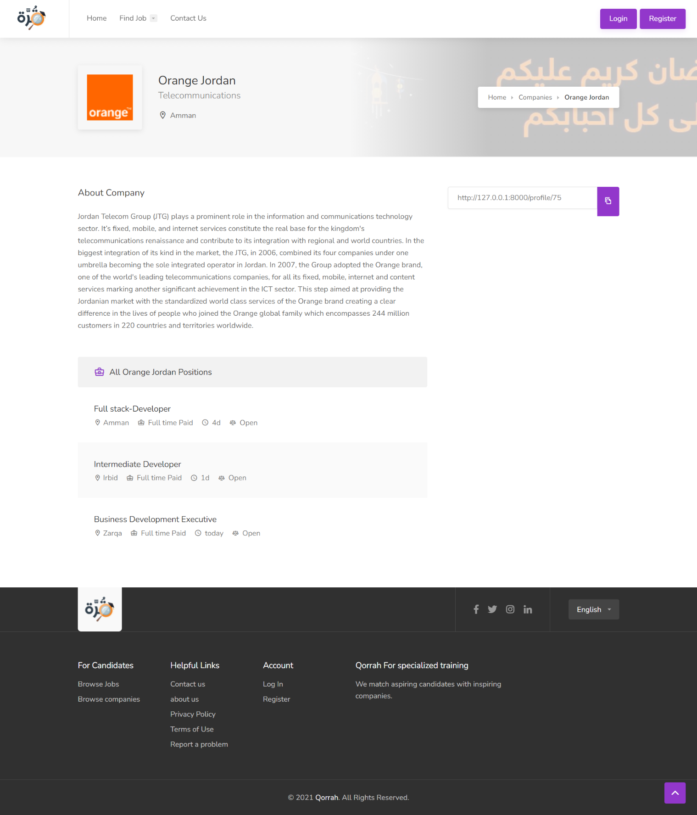
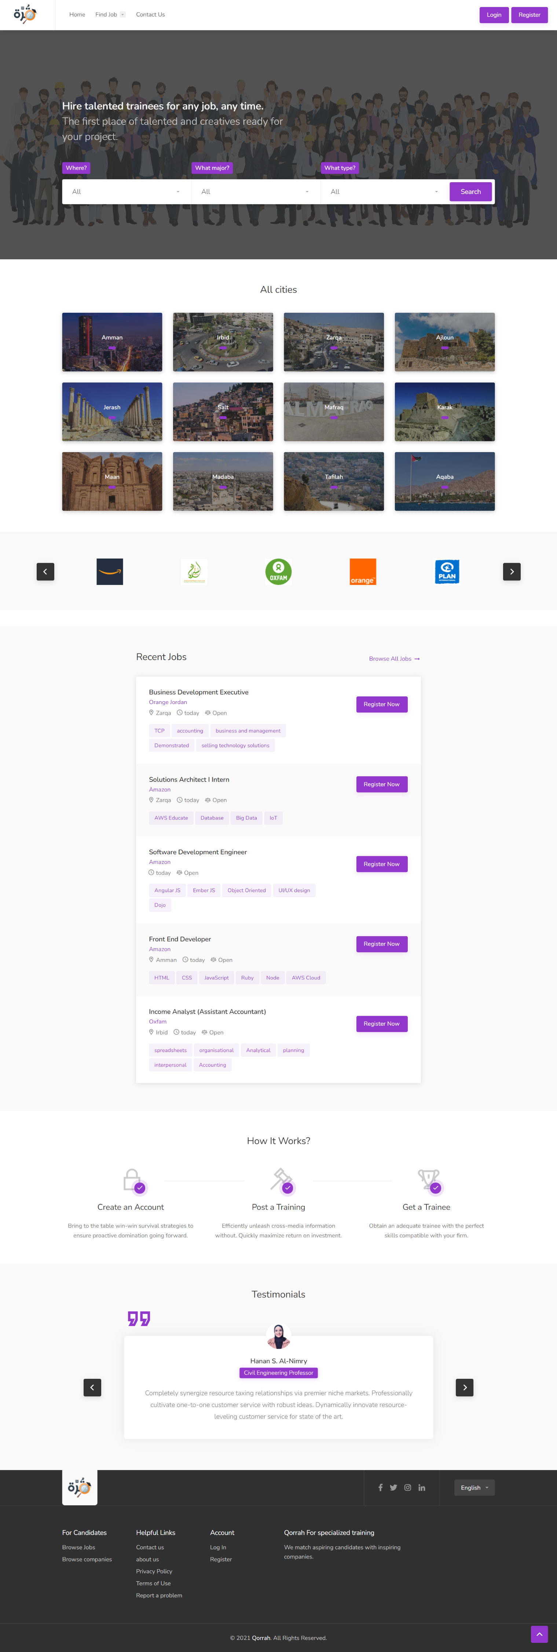
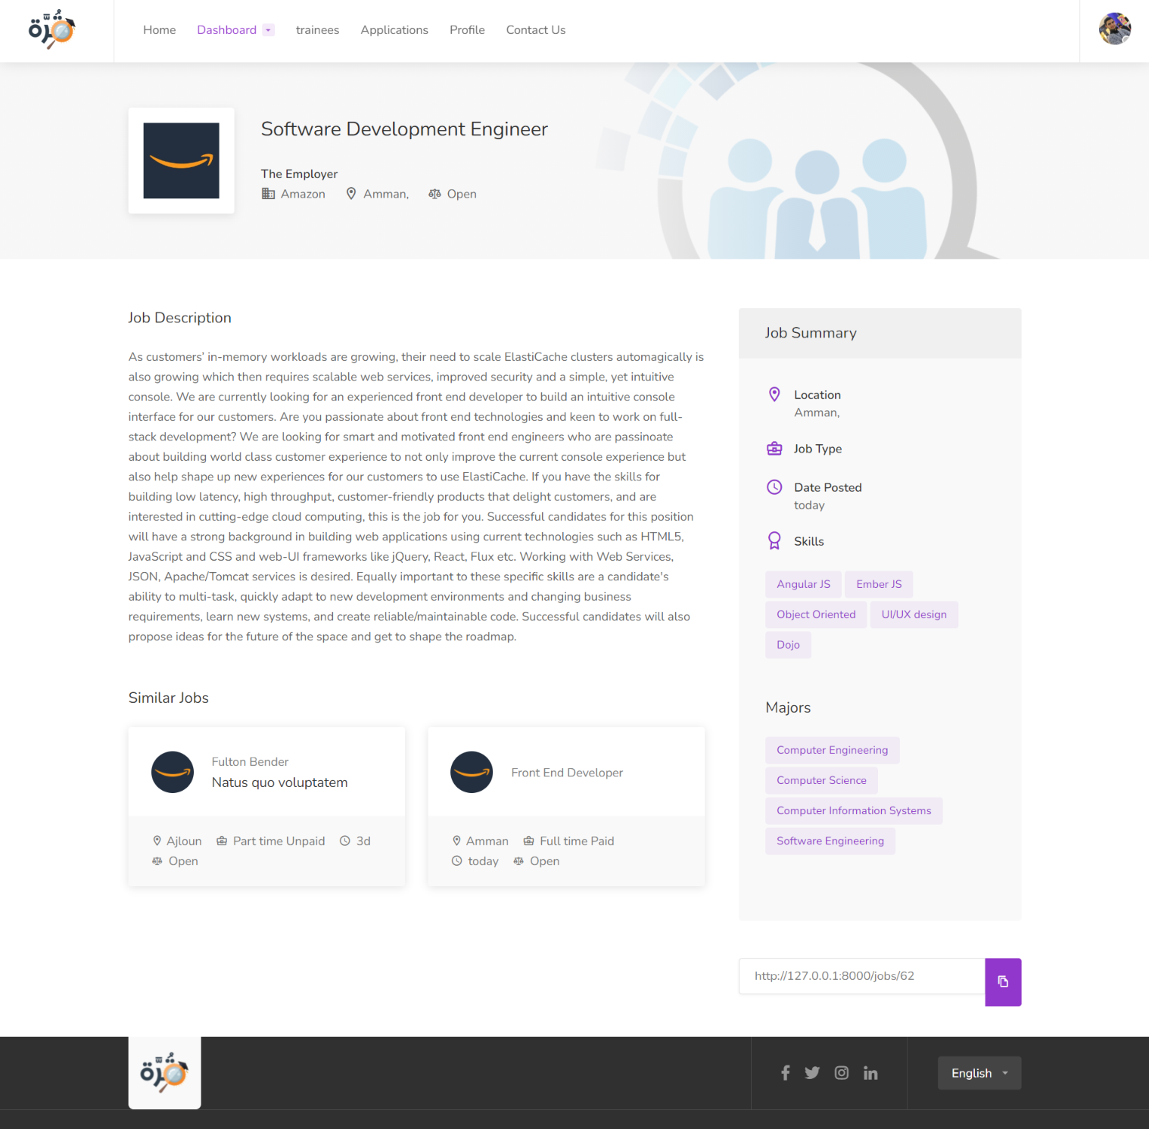
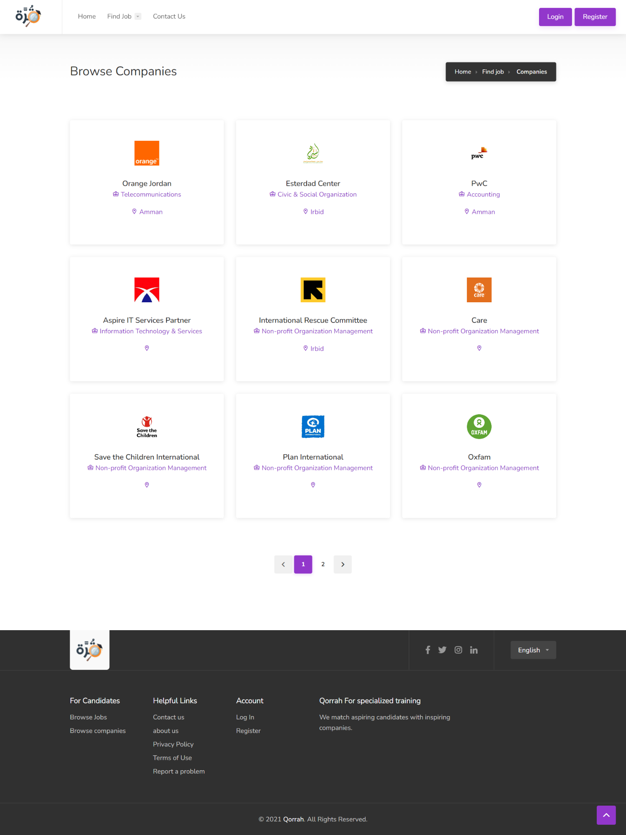
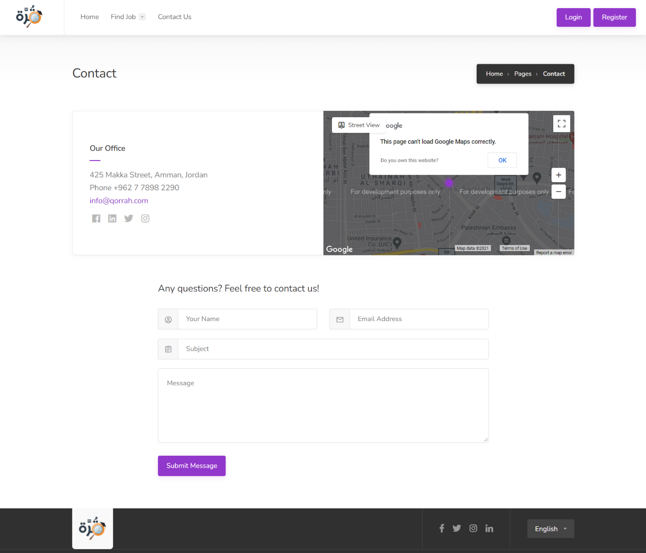

Slide 2

INTRODUCTION

Slide 3
Qorrah For
specialized training

Slide 4

University training

Slide 5

Specialized training

Slide 6
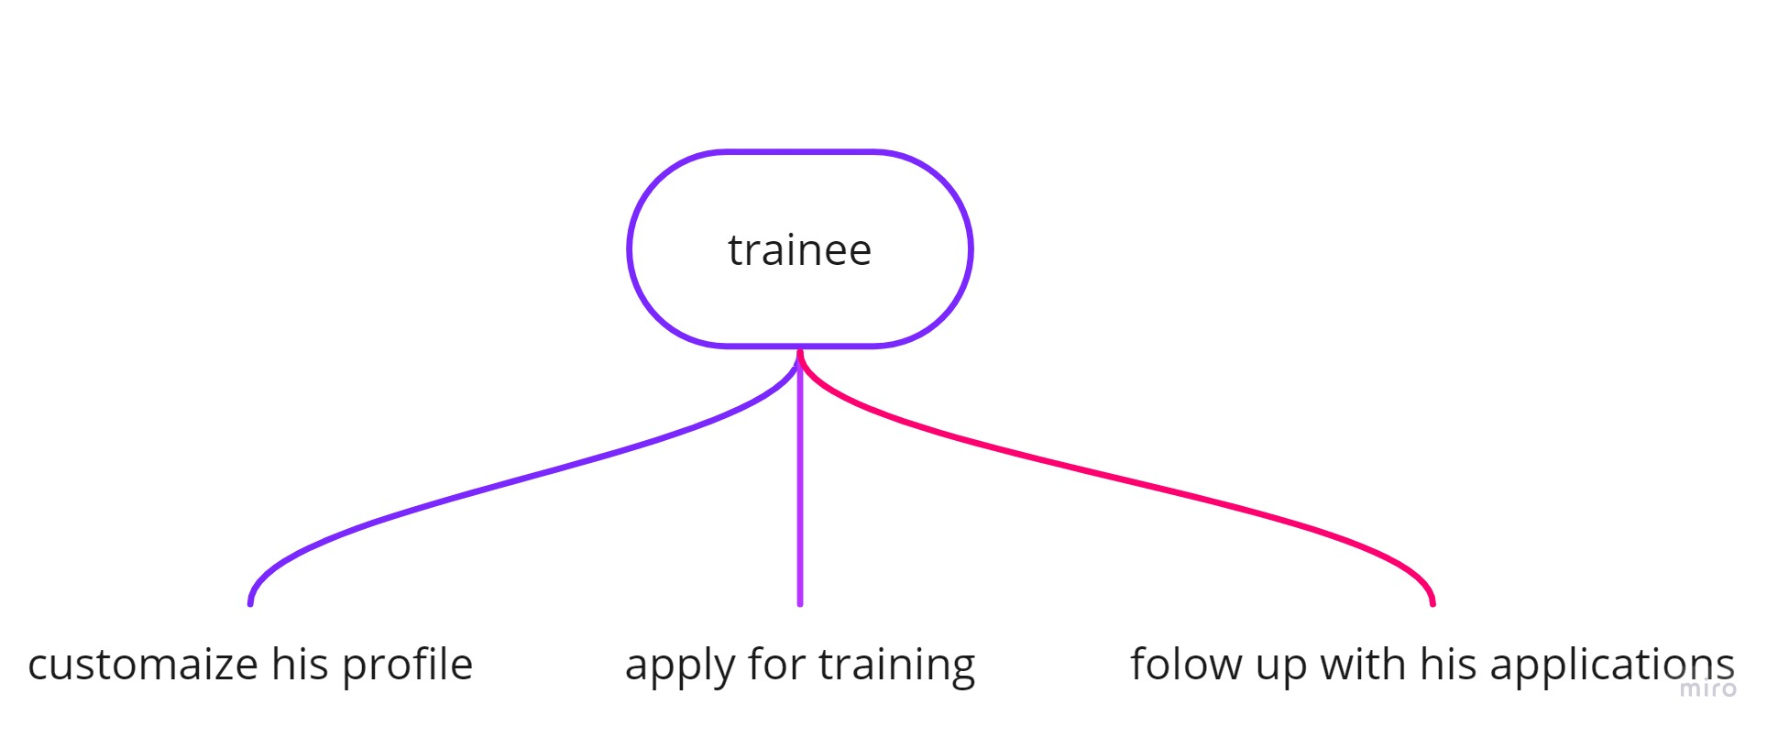
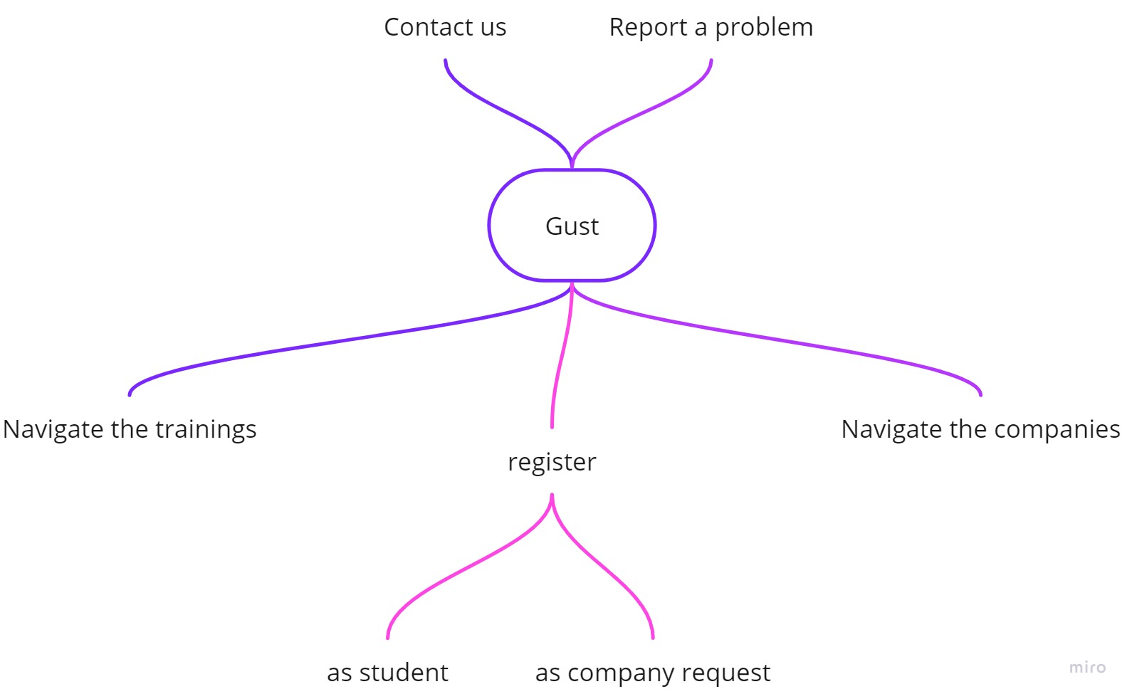
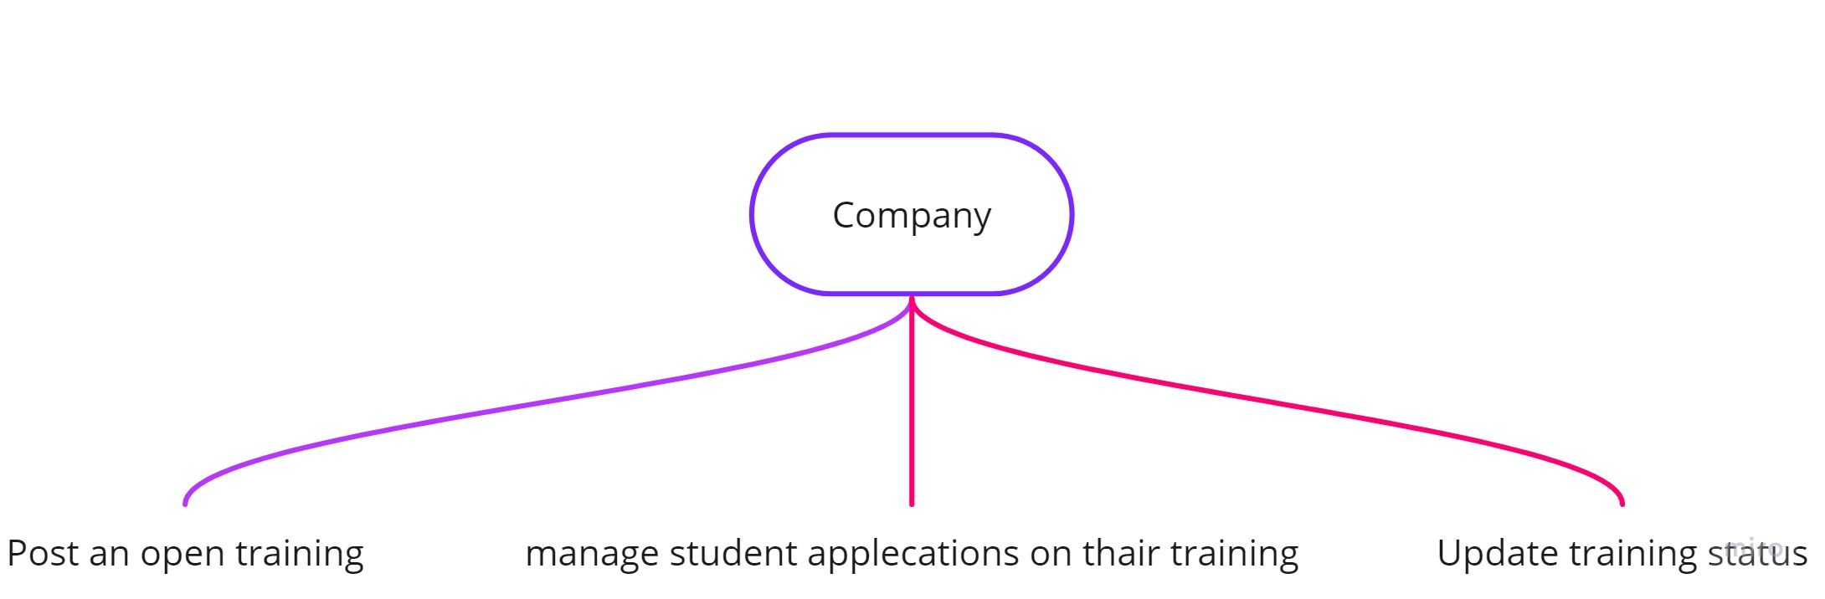
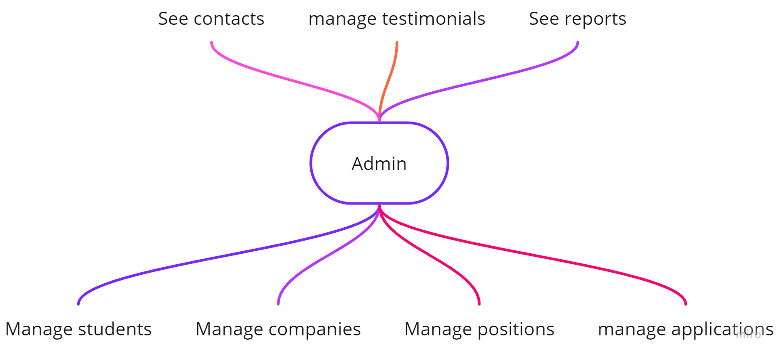
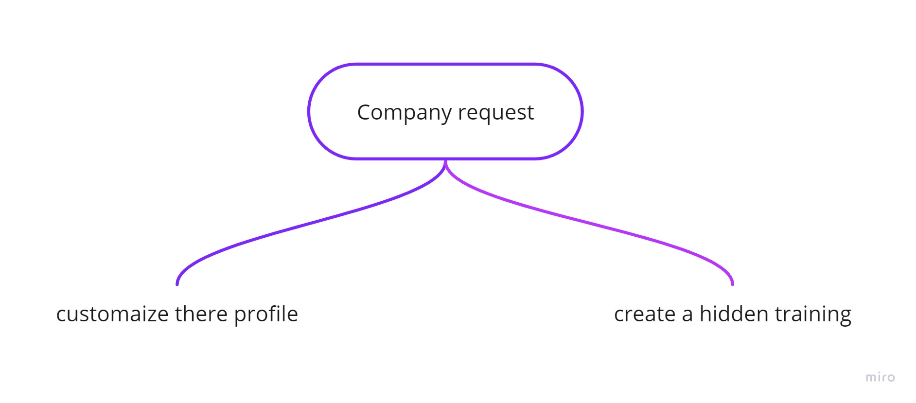
Use cases

Slide 7
Use cases

Slide 8
Use cases

Slide 9
Use cases

Slide 10
Use cases

Slide 11
Use cases

Slide 12



Logo
Visual Identity
Color typography
#9237cb
#a64bdb
#333333
#fafafa
Font family: Nunito
Notes:
Font : https://fonts.googleapis.com/css?family=Nunito:300,400,600,700,800&subset=latin-ext

Slide 13
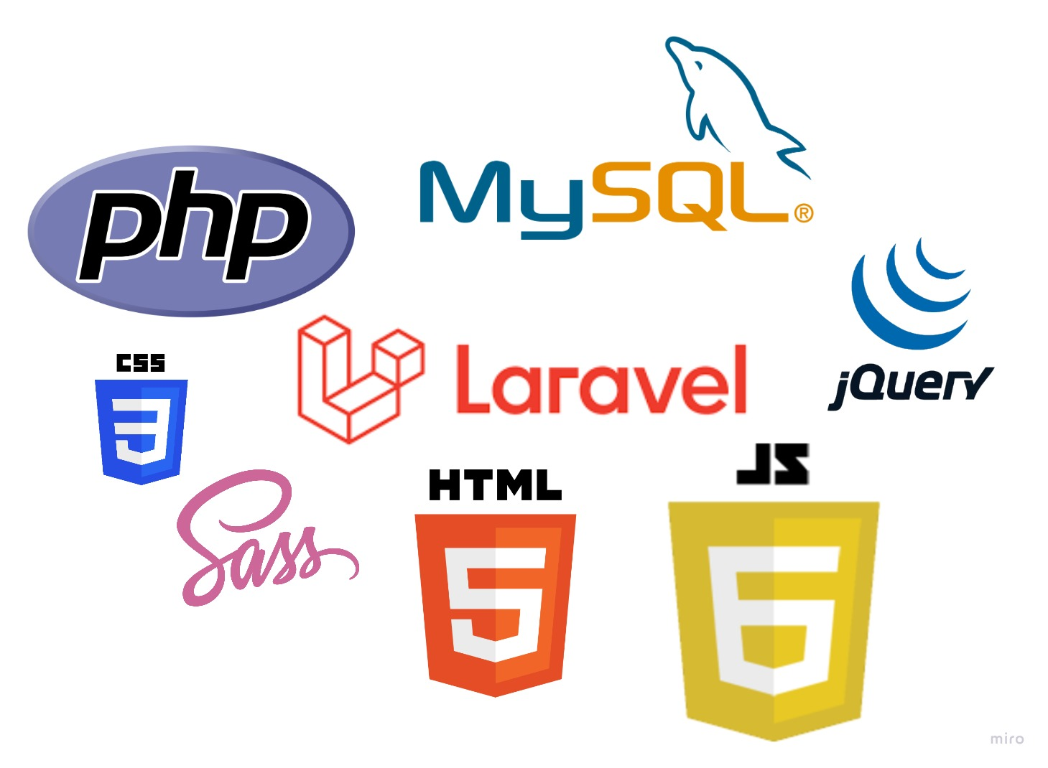
Technology used

Slide 14
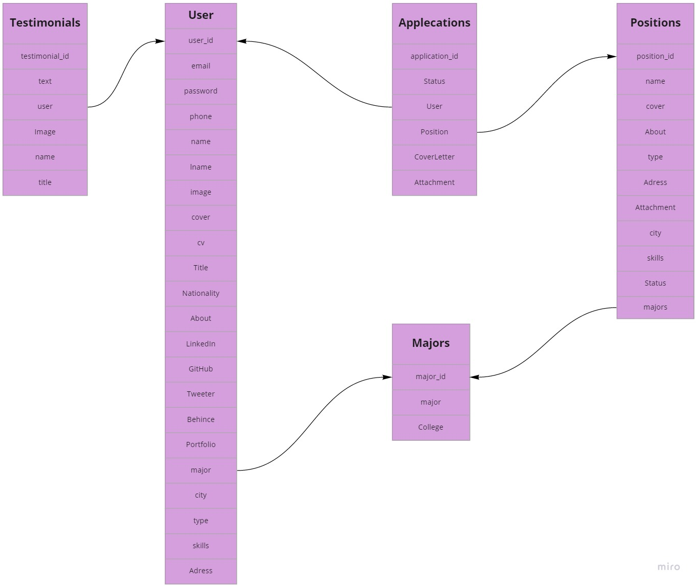
Database

Slide 15
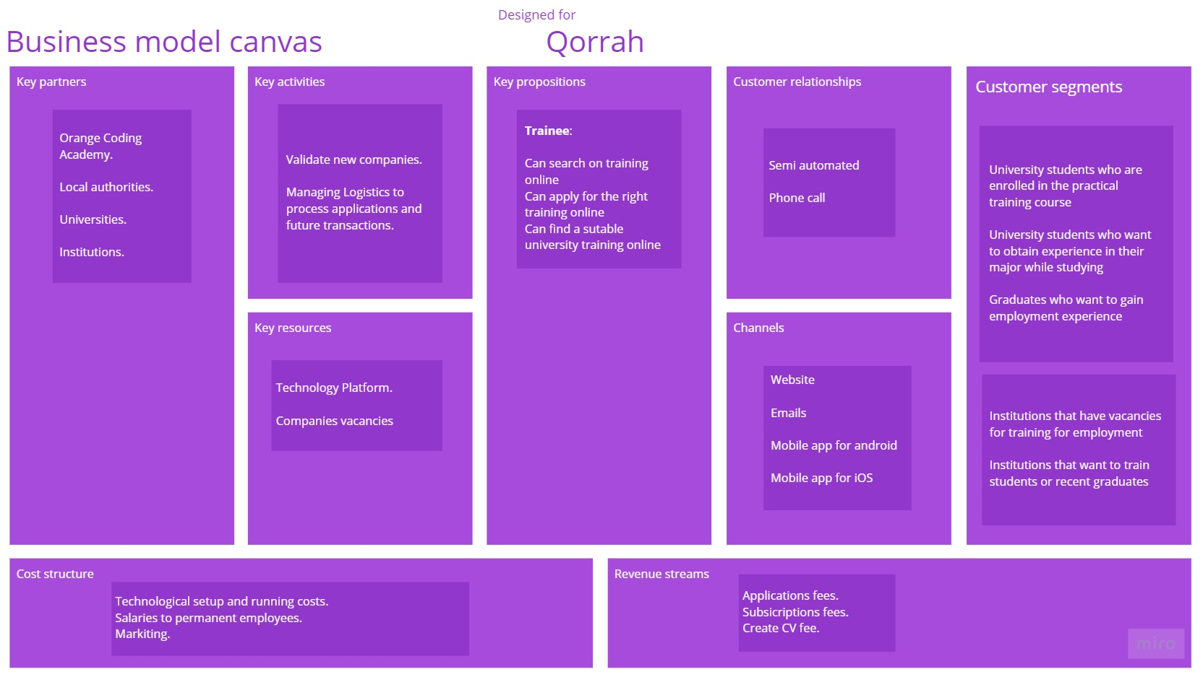

Slide 16
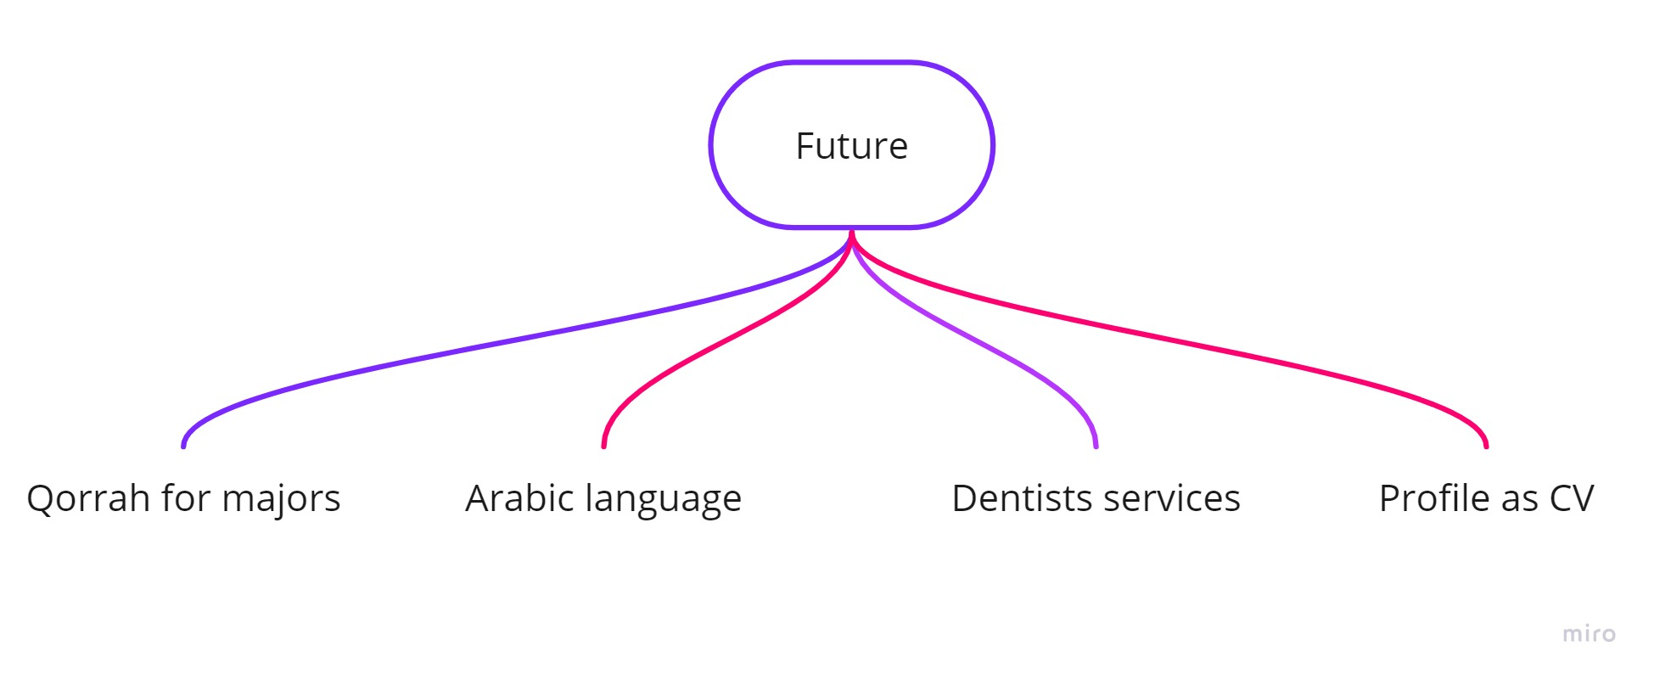
Next step

Slide 17


Slide 18

Demonstration

